Slide 1
16
Raising Capital

Slide 2

Chapter 16 – Index of Sample Problems
Slide # 02 - 03 Dutch auction
Slide # 04 - 05 IPO allocations
Slide # 06 - 07 Flotation costs
Slide # 08 - 09 Rights – Number of shares needed
Slide # 10 - 11 Rights – Number of rights
Slide # 12 - 18 Rights – Value of a right
Slide # 19 - 20 Dilution – Ownership
Slide # 21 - 25 Dilution – Accounting and financial
Slide # 26 - 30 Dilution – Portfolio value

Slide 3
2: Dutch auction
The Samson Co. wants to sell 1,000 shares of stock. The shares are to be sold in a Dutch auction. The following bids have been received.
Bidder Quantity Price
A 200 $23
B 400 $21
C 600 $19
D 500 $18
How much will the company receive per share of stock sold?

Slide 4
3: Dutch auction
The Samson Co. wants to sell 1,000 shares of stock.
Bidder Quantity Price Total Quantity
A 200 $23 200 = 200
B 400 $21 200 + 400 = 600
C 600 $19 200 + 400 + 600 = 1,200
D 500 $18
How much will the company receive per share of stock sold?

Slide 5
4: IPO Allocations
You have placed orders to purchase 100 shares of each of three IPOs. Each IPO is priced at $10 a share. The number of shares you are allocated and the market price at the end of the first day are:
Stock Shares allocated Market price
A 100 $ 8.00
B 80 $11.00
C 20 $15.00
What is the amount of your total profit or loss on these stocks as of the end of the first day of trading?

Slide 6
5: IPO allocations
Number of shares × (Ending price – Cost) | Profit or Loss
100 × ($ 8 - $10) | -$200
80 × ($11 - $10) | $ 80
20 × ($15 - $10) | $100
Total | -$ 20

Slide 7
6: Flotation costs
The Alpha Co. wants to raise $20 million to fund a new project.
The company estimates that it will spend $500,000 for
accounting, legal and other costs related to the issue. The
underwriting spread is 7.5 percent. The issue price of the stock
is $25 a share.
How many shares of stock does the Alpha Co. need to sell?

Slide 8
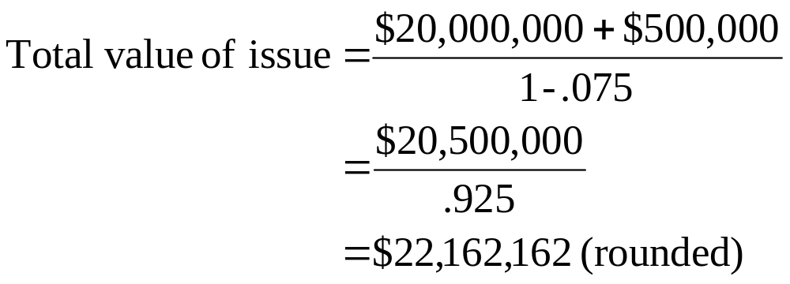
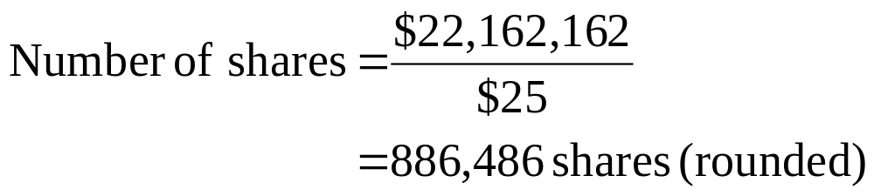
7: Flotation costs

Slide 9
8: Rights – Number of shares needed
Tell Me Why, Inc. wants to raise $6 million to develop a new website designed for kids. The company has decided to do this through a rights offering with a subscription price of $40. The current market price of Tell Me Why, Inc. stock is $51.59 per share.
How many new shares of stock does the company need to sell?
Note: The subscription price is less than the current market price.
This is necessary if a right is to have any value.

Slide 10
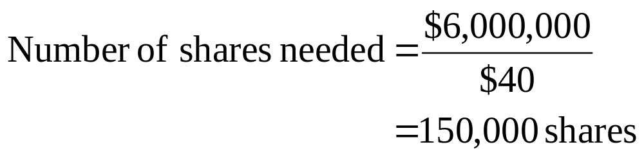
9: Rights – Number of shares needed

Slide 11
10: Rights – Number of rights
Telephoto, Inc. wants to raise $12 million through a rights offering. Each shareholder will receive one right for each share they own. The subscription price has been set at $20. Currently, the company has 1.5 million shares outstanding with a current market price of $28.45 a share.
How many rights will be issued?
How many rights will be needed to purchase one new share of stock in this offering?

Slide 12

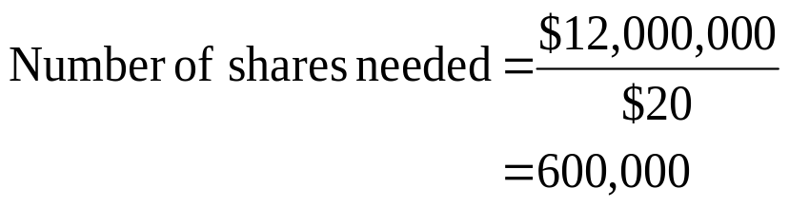
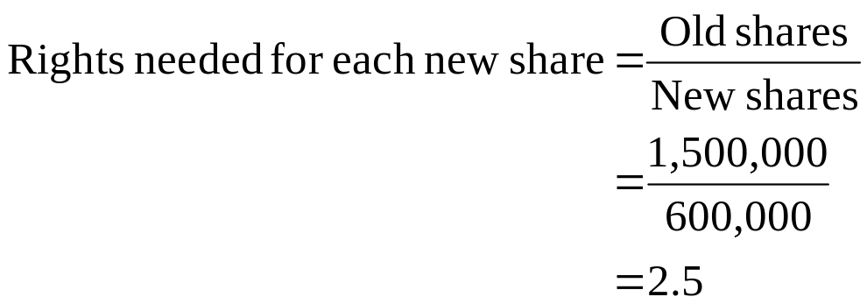
11: Rights – Number of rights
The company will issue 1.5 million rights since there are 1.5 million shares of stock outstanding.

Slide 13
12: Rights – Value of a right
Kurt currently owns 4 shares of Ideals, Inc. These shares have a market value of $36 each. Ideals just announced the details of a new rights offering. The company will issue one right per share of outstanding stock. The new shares in this offering are priced at $20 plus 4 rights.
What is the value of one right?

Slide 14
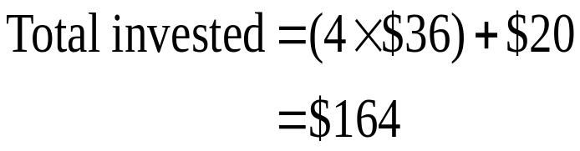
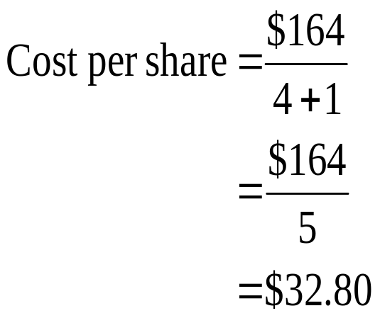
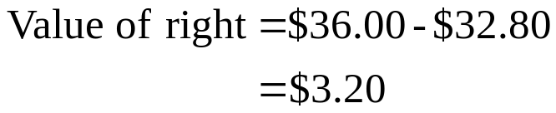
13: Rights – Value of a right

Slide 15
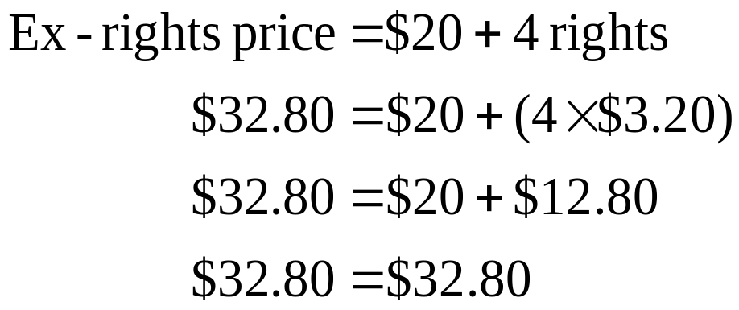
14: Rights – Value of a right

Slide 16
15: Rights – Value of a right
Alexander & Co. currently has a total firm value of $21.6 million.
The company has decided to raise another $6 million through a rights offering. The subscription price is $15 per new share purchased. The company currently has 1.2 million shares outstanding and will issue one right per outstanding share.
How many rights will be needed to purchase one new share?
What is the value of one right?

Slide 17
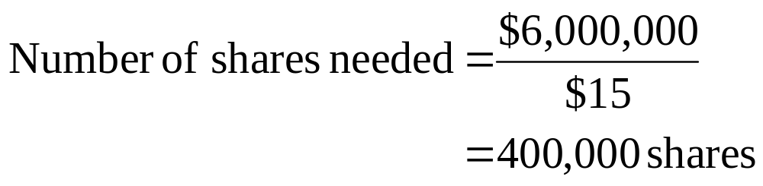
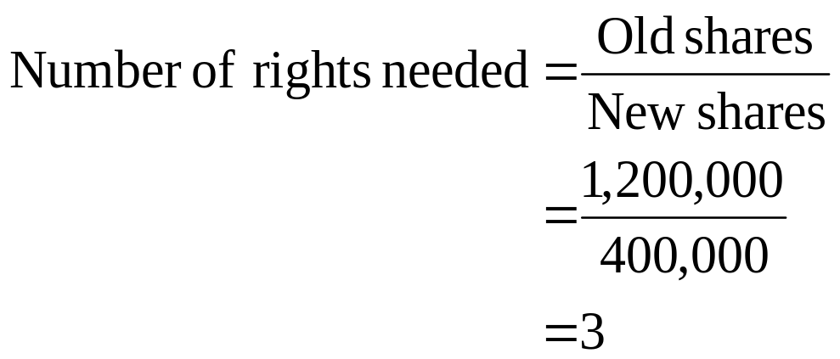
16: Rights – Value of a right

Slide 18
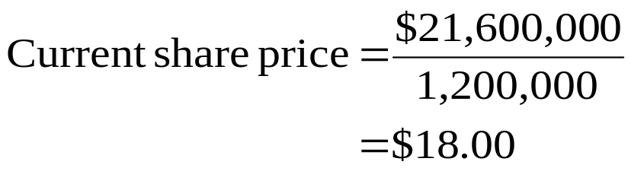
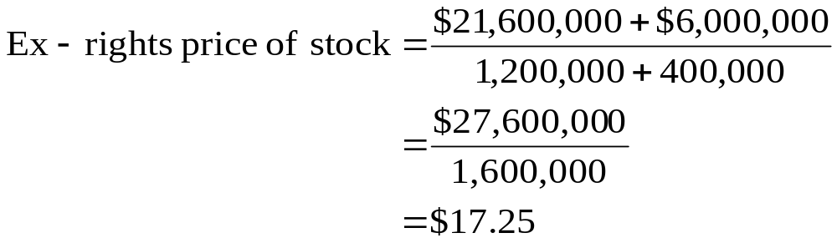
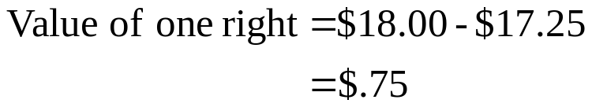
17: Rights – Value of a right

Slide 19
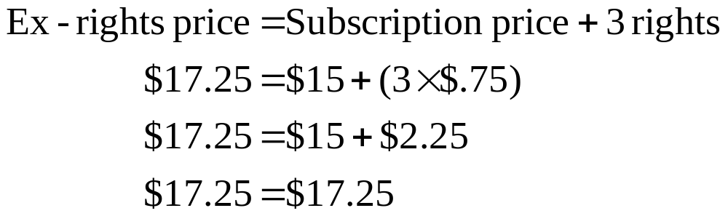
18: Rights – Value of a right

Slide 20
19: Dilution - Ownership
Tomas owns 3,500 shares of stock in Hot Tamales. The company currently has 25,000 shares outstanding and is preparing to sell an additional 10,000 shares to finance future expansion. Tomas is not going to purchase any additional shares.
How will Tomas’ ownership position in Hot Tamales change as a result of this new issue of stock?

Slide 21
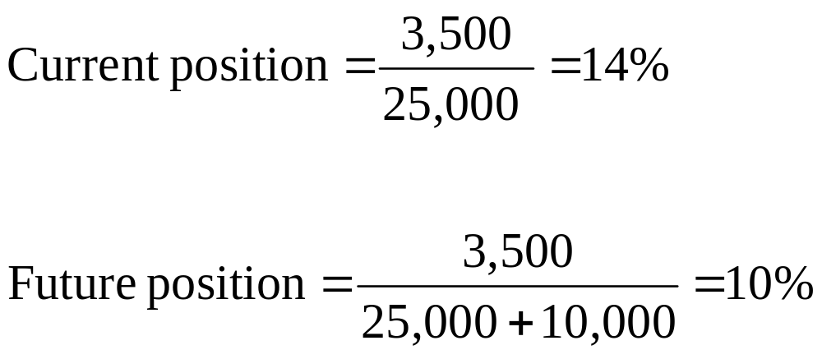
20: Dilution - Ownership

Slide 22
21: Dilution – Accounting and financial
JKL, Inc. has compiled information on their current financial status as seen in the table on the next slide. The company is analyzing the financial impact of a proposed project. The project requires an initial investment of $200,000 for fixed assets. This investment will be funded by issuing additional shares of stock. The project has a net present value of $100,000 and a price / earnings ratio equal to that of the firm.
Given this information, can you complete the last column on the next slide to show how the various values will change if the project is implemented?

Slide 23
22: Dilution – Accounting and financial
 | Current firm | Firm with new project
Shares outstanding | 200,000
Book value | $1 million
Book value per share | $5
Market value | $1.6 million
Market value per share | $8
Net income | $100,000
Return on equity | 10%
Earnings per share | $.50
Earnings per share / Price | .0625
Price / Earnings per share | 16
Price / Book | 1.6

Slide 24
23: Dilution – Accounting and financial
Here are some questions to help you:
What will the book value of the company be if you add $200,000 of fixed assets to the current book value?
What will the market value of the company be if you add $200,000 of fixed assets plus $100,000 from the net present value of the project to the current market value?
How many shares of stock will need to be sold at the current market price to raise the $200,000 needed to buy assets?

Slide 25
24: Dilution – Accounting and financial
What is the market value per share?
If the market value per share, also called the price, is $8.4444 and the price / earnings ratio is 16, what is the earnings per share?
If you multiply the earnings per share times the number of shares, won’t you get the net income?
Isn’t the return on equity equal to the net income divided by the book value?

Slide 26
25: Dilution – Accounting and financial
 | Current firm | Firm with new project
Shares outstanding | 200,000 | 225,000
Book value | $1 million | $1.2 million
Book value per share | $5 | $5.3333
Market value | $1.6 million | $1.9 million
Market value per share | $8 | $8.4444
Net income | $100,000 | $118,755
Return on equity | 10% | 9.90%
Earnings per share | $.50 | $.5278
Earnings per share / Price | .0625 | .0625
Price / Earnings per share | 16 | 16
Price / Book | 1.6 | 1.58

Slide 27
26: Dilution – Portfolio value
You own 5,000 shares of ABC Co. This represents a 20% ownership position. The current market price of ABC stock is $40 a share.
By what percentage will your portfolio value change if the company sells an additional 5,000 shares of stock at $38 a share and you do not buy any?

Slide 28
27: Dilution – Portfolio value
Here are some questions to help you answer this problem:
How many shares of stock are currently outstanding?
What is the current value of the firm?
How many shares will be outstanding after the new issue is released?
By how much will the value of the firm increase when the new shares are sold?

Slide 29
28: Dilution – Portfolio value
How many shares of stock are currently outstanding?
5,000 ÷ .20 = 25,000
What is the current value of the firm?
25,000 × $40 = $1,000,000
How many shares will be outstanding after the new issue is released?
25,000 + 5,000 = 30,000
By how much will the value of the firm increase when the new shares are sold?
$1,000,000 + (5,000 × $38) = $1,190,000

Slide 30
29: Dilution – Portfolio value
What is the new price per share?
What is your new portfolio value?
What was your original portfolio value?
What is the percentage change in the value of your portfolio?

Slide 31
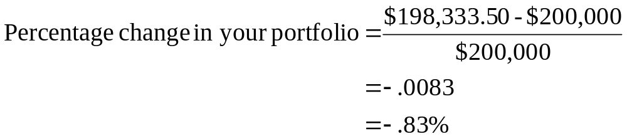
30: Dilution – Portfolio value
What is the new price per share?
$1,190,000 ÷ 30,000 = $39.6667
What is your new portfolio value?
5,000 × $39.6667 = $198,333.50
What was your original portfolio value?
5,000 × $40.00 = $200,000.00
What is the percentage change in the value of your portfolio?

Slide 32
16
End of Chapter 16

